Slide 1
Introduction to P4
Aditya dogra : addogra@cisco.com

Slide 2
Agenda
SDN – Experimental to Practical
P4 Design Goals
Switching Pipeline
P4 Language Intro
P4 Program Structure
Demo
NXOS Roadmap

Slide 3
SDN

Slide 4


Network Paradigm was stagnant till 2012
Over the years…
this network paradigm has
remained mostly intact…
Control and Data Plane resides within Physical Device

Slide 5
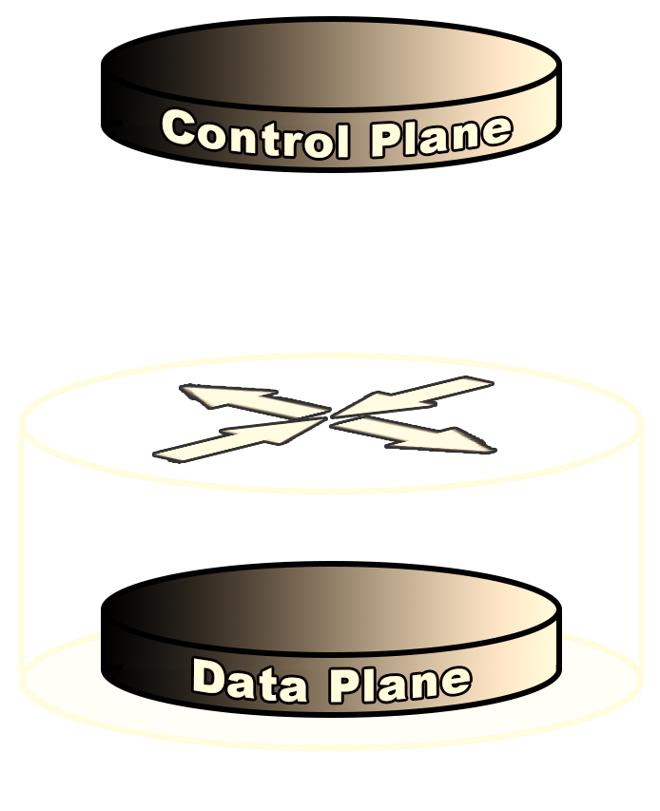

Network Paradigm is changing
In other words…
In the SDN paradigm, not all processing happens inside the same device
Wiki Defines , Software defined networking (SDN) is an approach to building computer networks that separates and abstracts elements of these systems

Slide 6

Where did SDN come from !!!
You might have noticed the Cisco Logo on the web page
Cisco provided some equipment early in the cycle to the research team
Namely a Catalyst 6500 and 3750 upon which some of the early work was done…

Slide 7
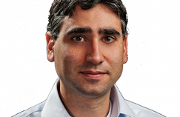
The Origin of SDN
Martin Casado
2006: Martin Casado, a PhD student at Stanford and team propose a clean-slate security architecture (SANE) which defines a centralized control of security (in stead of at the edge as normally done). Ethane generalizes it to all access policies.
The idea of Software Defined Network is originated from OpenFlow project (ACM SIGCOMM 2008).
2009: Stanford publishes OpenFlow V1.0.0 specs.
June 2009: Martin Casado co-founds Nicira.
March 2011: Open Networking Foundation is formed.
Oct 2011: First Open Networking Summit. Many Industries (Juniper, Cisco announced to incorporate.
July 2012: VMware buys Nicira for $1.26B.

Slide 8
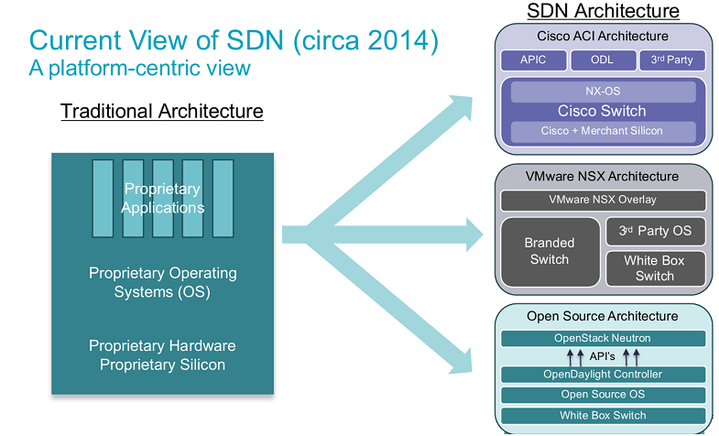
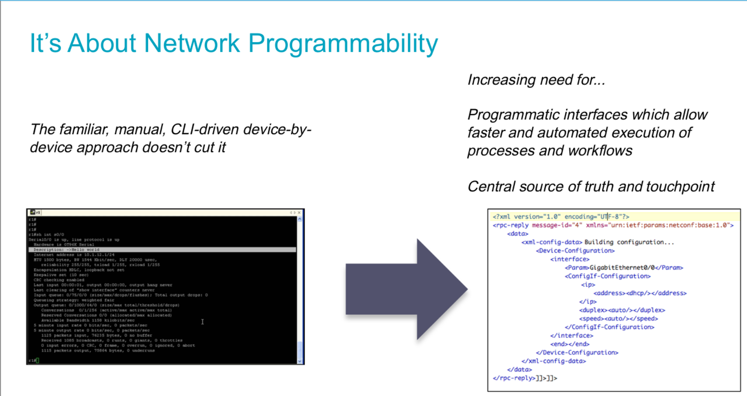
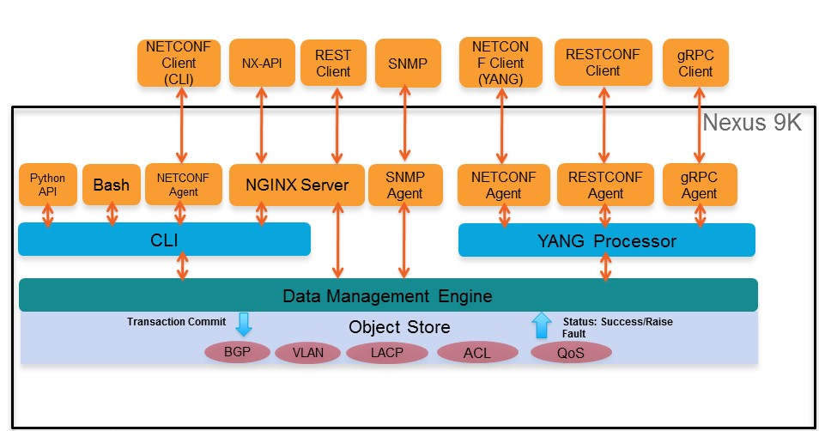
What does SDN look like now ?
Nexus 9000 – Programming Interfaces

Slide 9
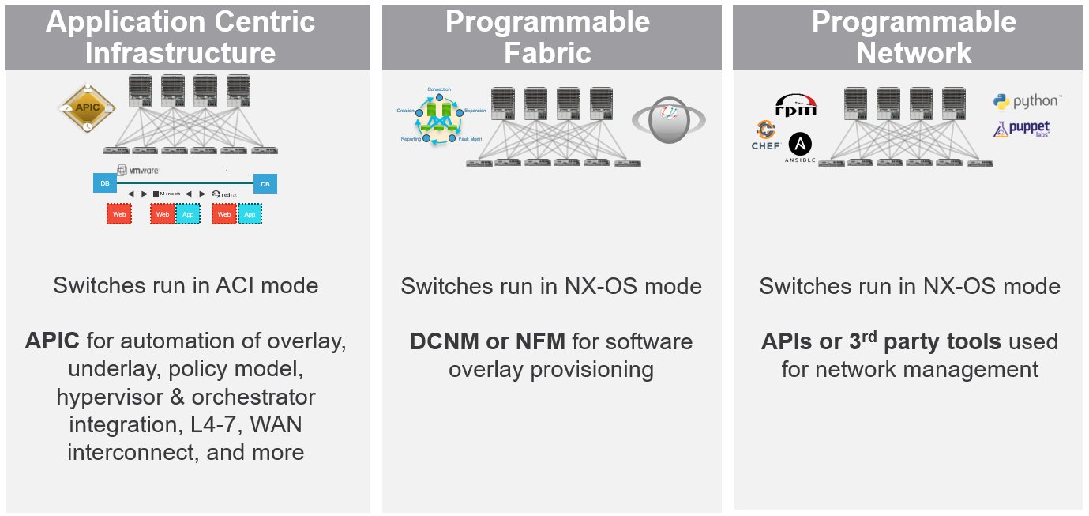







ACI Provides Choice for Programmability and Automation
This is the focus for today’s session
Application Centric Infrastructure
Programmable Fabric
Programmable Network
Connection
Creation
Expansion
Reporting
Fault Mgmt
DB
DB
Web
Web
App
Web
App
Switches run in ACI mode
APIC for automation of overlay, underlay, policy model, hypervisor & orchestrator integration, L4-7, WAN interconnect, and more
Switches run in NX-OS mode
DCNM or NFM for software overlay provisioning
Switches run in NX-OS mode
APIs or 3rd party tools used for network management

Slide 10
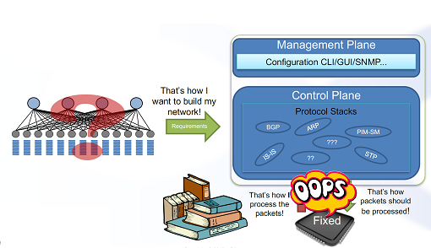
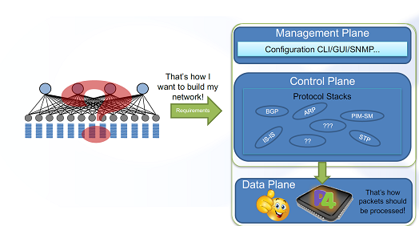
Let’s program whatever is left !!

Slide 11
P4 - Programming Protocol-independent Packet Processors

Slide 12
P4 Goals
Protocol Independence
Target Independence
Re-configurability in the field
Low cost for testing new protocol development.

Slide 13
P4 design goals
Specify behavior of part of a packet forwarding fast path
Possible to compile to several kinds of targets, including:
ASICs with enough flexibility designed into them, like Barefoot’s Tofino, and Cisco’s Doppler
FPGAs
Programmable NICs (e.g. Netronome)
NPUs that uses processor cores like Intel, ARM, PowerPC, etc. such as Cisco CPP family, probably EZchip
Programmable packet filters in Linux kernel like EBPF (Extended Berkeley Packet Filter)
Software behavioral model, for testing of data packet behavior and interaction with control plane code
Explicit definition of tables enables auto-generation of lowest level portions of control plane code from P4 source code:
Table read/write/modify APIs, and their implementation

Slide 14
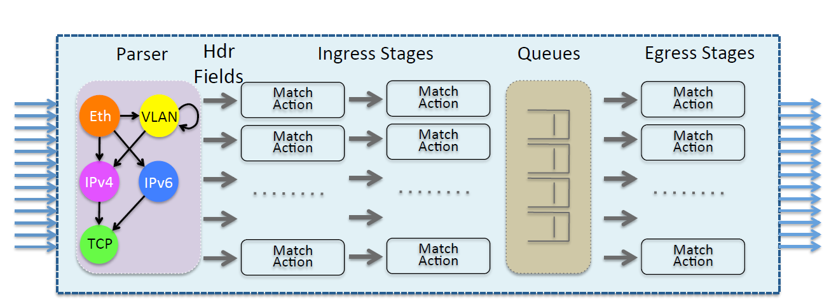
Abstract Forwarding Model

Slide 15
Basic Forwarding organization

Slide 16
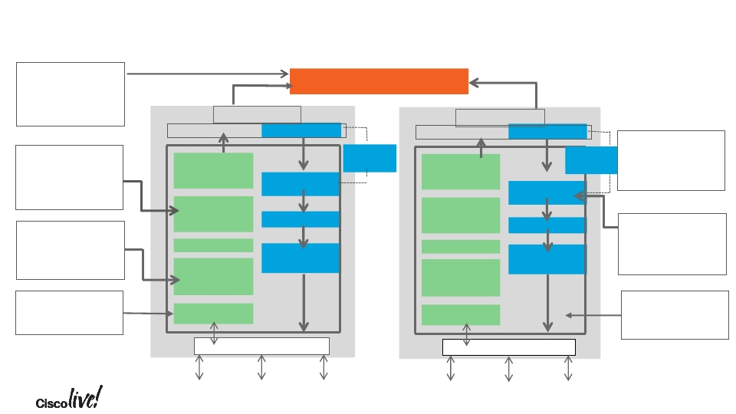
Nexus9500 Unicast Packet Flow
Fabric Module
Performs L3 LPM
lookup and
Fabric Module
L3 LPM Lookup & Forwarding
resolves Egress
port and next-hop
Ingress Line Card
Egress Line Card
ALE-NS
EoQ
ALE-NS
EoQ
Additional buffer
Classify traffic
based on 802.1q
COS, IP Pres,
DSCP &ACL
Remark if needed
Ingress
Accounting &
Policing
Traffic
T2-NFE
Output Q
& Shaping
OOBFC
Signaling
Ingress
Accounting &
Policing
Traffic
T2-NFE
Output Q
& Shaping
OOBFC
Signaling
is available for
extended out put
Ques EoQ
Classification
& Remarking
I-ACL
L2/L3
Lookup &
forwarding
Parser
E-ACL
Packet
Modification
Classification
& Remarking
I-ACL
L2/L3
Lookup &
forwarding
Parser
Class-based
output queues.
Support 6 classes
including control
traffic class
Egress Line card
sends packet to
egress port based
on DMOD/DPORT
E-ACL
Packet
Modification
L2/L3 Lookup in
MAC Table and IP
Host Table
Parse the first 128
Byte and extract
header info
Network Interface
Network Interface
BRKDCT-3101
© 2016 Cisco and/or its affiliates. All rights reserved. Cisco Public
15

Slide 17
P4 non-goals
No features for specifying behavior of buffering and queue scheduling parts of a forwarding ASIC.
There is a published research paper on programmable packet scheduler, so there may be a language proposed for this in the future. [1]
P4 program in a switch does pick which queue to put the packet into
Not a general purpose programming language.
Not appropriate for writing control plane code.
[1] ”Programmable Packet Scheduling at Line Rate”, Anirudh Sivaraman, Suvinay Subramanian, Mohammad Alizadeh, Sharad Chole, Shang-Tse Chuang, Anurag Agrawal, Hari Balakrishnan, Tom Edsall, Sachin Katti, Nick McKeown

Slide 18
Example ‘very simple switch’ architecture
Blue, green, arbiter, demux/queue are defined by the target architecture, outside of P4.
Other target architectures are possible, e.g. without queuing, without recirculation, with a separate ingress & egress match-action pipeline for a single chip switch
White and red: P4 programmable

Slide 19
What is generated by P4 compiler
Dataplane runtime and contents of both API boxes are auto-generated by P4 compiler
Control-plane in red will typically be orders of magnitude larger and more complex than the auto-generated code in the API box
The part of the data plane and control plane that handles buffering and queuing is not shown here, but of course needs to be there for an implementation of a router/switch.

Slide 20
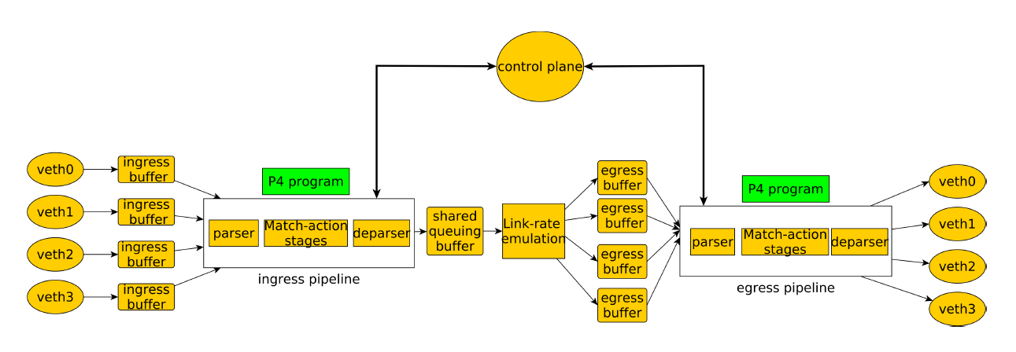
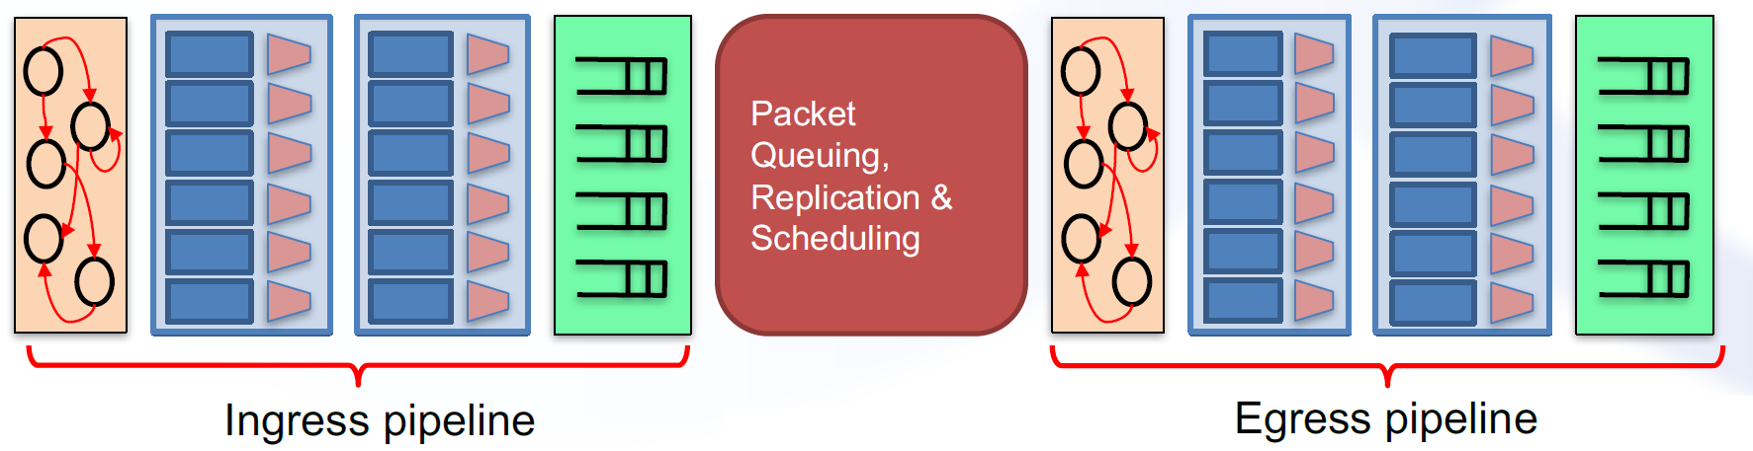
Where does P4 program fits in
Ingress Parser (Not P4 program)
Ingress Parser (P4 Program)
Match Action Unit (P4 Program)
Egress Parser (P4 Program)
Match Action Unit (P4 Program)
Egress Parser (P4 Program)
Not P4 Program

Slide 21
P4 Language

Slide 22
P4 language
This talk focuses on P4_16 version of language.
Start with C
Remove: loops, recursion, pointers, arrays(with an exception : array of headers is allowed, not other usual contructs) , malloc(), free(), unions, chars, floats, doubles
All P4 programs can provably be executed in time and memory that is linear in the number of header bytes examined (assuming O(1) implementation of table search operations).
Eliminating loops and recursion makes this possible.
Eliminating pointers makes static analysis and compilation to hardware targets simpler – no pointer aliasing.
https://en.wikipedia.org/wiki/Aliasing_(computing)

Slide 23
P4 language
Keep: int, struct, bit fields, if statements, function calls, arrays of headers
Two kinds of ‘structs of bits fields’ in P4 source code:
Keyword ‘header’ defines those packet headers extracted from incoming packets by parser
Keyword ‘struct’ defines data associated with a packet derived in other ways, e.g. from table lookups. Examples: VRF, logical interface derived from (port, VLAN)
Arrays of headers have max length known at compile time
Typical use case is a stack of MPLS headers.
At run time, the number of array elements that are valid can vary during the processing of a packet, e.g. for MPLS push/pop operations.

Slide 24
Typical P4_16 program structure
Define header types you want to be able to parse/send
Define struct types for metadata
Metadata being information about a packet that need not be in the packet, e.g. BD, VRF, remembered index into later rewrite table, …
parser
Containing one or more state definitions, with state transitions defined between them based on contents of headers.
control block for ingress match-action behavior
Containing one or more table definitions, each defining the search key fields and one or more action’s that the control plane gets to choose among when adding entries to the table.
Also contains an apply block of code defining the control flow between the tables.
Apply block and actions can have if statements, examine or modify header and metadata fields, add/remove headers, call extern functions, etc.
control block for egress match-action behavior
control block for deparser, creating the output packet headers
Package instantiation that ties them all together in a main object.

Slide 25
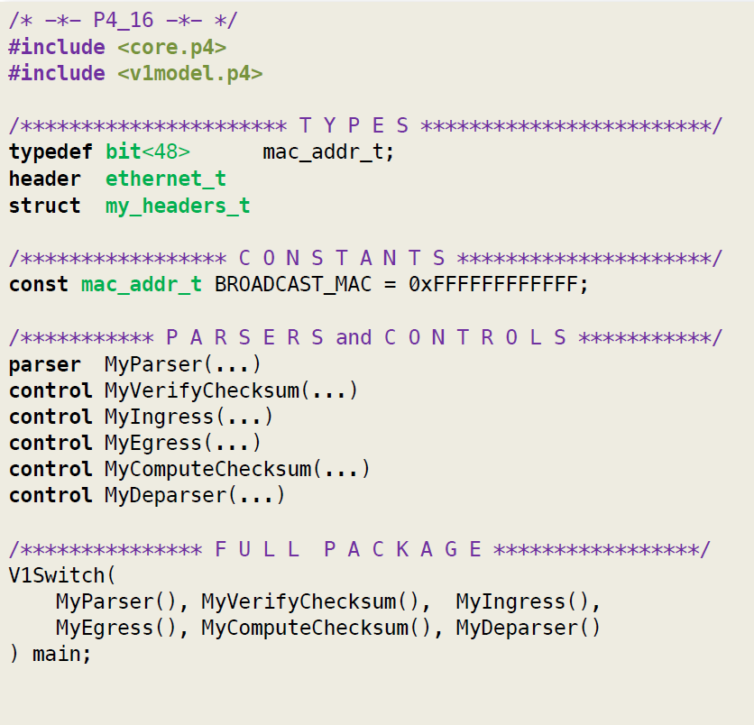
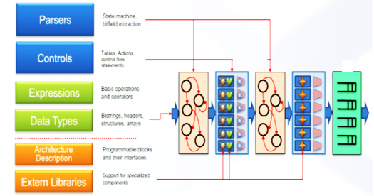
P4 Program structure
H/W Queues
Ingress Parser
Egress Parser
Ingress Match Action Unit
Egress Match Action Unit

Slide 26
Header Definitions
typedef bit<9> egressSpec_t;
typedef bit<48> macAddr_t;
typedef bit<32> ip4Addr_t;
header ethernet_t {
macAddr_t dstAddr;
macAddr_t srcAddr;
bit<16> etherType;
}
header ipv4_t {
bit<4> version;
bit<4> ihl;
bit<8> diffserv;
bit<16> totalLen;
bit<16> identification;
bit<3> flags;
bit<13> fragOffset;
bit<8> ttl;
bit<8> protocol;
bit<16> hdrChecksum;
ip4Addr_t srcAddr;
ip4Addr_t dstAddr;
}
struct headers {
ethernet_t ethernet;
ipv4_t ipv4;
}

Slide 27
Parser
parser ParserImpl(packet_in packet,
out headers hdr,
inout metadata meta,
inout standard_metadata_t standard_metadata) {
state start {
transition parse_ethernet;
}
state parse_ethernet {
packet.extract(hdr.ethernet);
transition select(hdr.ethernet.etherType) {
TYPE_IPV4: parse_ipv4;
default: accept;
}
}
state parse_ipv4 {
packet.extract(hdr.ipv4);
transition accept;
}
}

Slide 28
Control flow
control ingress(inout headers hdr, inout metadata meta, inout standard_metadata_t standard_metadata) {
action drop() {
mark_to_drop();
}
action ipv4_forward(macAddr_t dstAddr, egressSpec_t port) {
standard_metadata.egress_spec = port;
hdr.ethernet.srcAddr = hdr.ethernet.dstAddr;
hdr.ethernet.dstAddr = dstAddr;
hdr.ipv4.ttl = hdr.ipv4.ttl - 1;
}
table ipv4_lpm {
key = {
hdr.ipv4.dstAddr: lpm;
}
actions = {
ipv4_forward;
drop;
NoAction;
}
size = 1024;
default_action = NoAction();
}
apply {
if (hdr.ipv4.isValid()) {
ipv4_lpm.apply();
}
}
}

Slide 29
Deparser

Slide 30
DEMO

Slide 31
Basic IPV4 Forwarding

Slide 32
A very simple example
H1
Eth0: 10.0.1.10 : 00:04:00:00:00:01
Eth1 00:aa:00:01:00:01
S1
P4 Enabled Virtual Switch
S1
Eth3 00:bb:00:01:00:02
Eth2 00:bb:00:01:00:01
S1 , S2 , S3 are P4 Enabled Virtual Switches H1 , H2 and H3 are Hosts created in Mininet Thrift is used to configure all these devices
P4apprunner is used as a wrapper script to compile the p4 program to p4 json to the switches S1, S2, S3
Eth2 00:dd:00:01:00:02
Eth2 00:cc:00:01:00:02
S3
S2
Eth3 00:dd:00:01:00:03
Eth3 00:cc:00:01:00:03
S3
Eth1 00:aa:00:03:00:03
Eth1 00:aa:00:02:00:02
Eth0 10.0.3.10 : 00:04:00:00:00:03
Eth0 10.0.2.10 : 00:04:00:00:00:02
H3
H2

Slide 33
For traffic flowing from H1 -----→ H2
At H1
Src 10.0.1.10 src mac : 00:04:00:00:00:01
Dest 10.0.2.10 : dst mac : ff:ff:ff:ff:ff:ff
Egress port = eth0
S1
Src ip 10.0.1.10 src mac : 00:bb:00:01:00:01
Dest 10.0.2.10 : dst mac : ff:ff:ff:ff:ff:ff
Egress port = eth2
Ttl decrement
S2
Src ip 10.0.1.10 src mac : 00:aa:00:02:00:02
Dest 10.0.2.10 : dst mac : ff:ff:ff:ff:ff:ff
Egress port = eth 1
H1
Eth0: 10.0.1.10 : 00:04:00:00:00:01
Eth1 00:aa:00:01:00:01
S1
table_add ipv4_lpm ipv4_forward 10.0.2.10/32 => 00:bb:00:01:00:01 2
table_add ipv4_lpm ipv4_forward 10.0.1.10/32 => 00:aa:00:01:00:01 1
table_add ipv4_lpm ipv4_forward 10.0.3.10/32 => 00:bb:00:01:00:02 3
S1
Eth3 00:bb:00:01:00:02
Eth2 00:bb:00:01:00:01
table_add ipv4_lpm ipv4_forward 10.0.2.10/32 => 00:aa:00:02:00:02 1
table_add ipv4_lpm ipv4_forward 10.0.1.10/32 => 00:cc:00:01:00:02 2
table_add ipv4_lpm ipv4_forward 10.0.3.10/32 => 00:cc:00:01:00:03 3
Eth2 00:dd:00:01:00:02
Eth2 00:cc:00:01:00:02
table_add ipv4_lpm ipv4_forward 10.0.2.10/32 => 00:dd:00:01:00:03 3
table_add ipv4_lpm ipv4_forward 10.0.1.10/32 => 00:dd:00:01:00:02 2
table_add ipv4_lpm ipv4_forward 10.0.3.10/32 => 00:aa:00:03:00:03 1
S3
S2
Eth3 00:dd:00:01:00:03
Eth3 00:cc:00:01:00:03
S3
Eth1 00:aa:00:03:00:03
Eth1 00:aa:00:02:00:02
Eth0 10.0.3.10 : 00:04:00:00:00:03
Eth0 10.0.2.10 : 00:04:00:00:00:02
H2
H3

Slide 34
H1-> H2
Src 10.0.1.10
Dest 10.0.2.10
H1 → S1
S1 parse packet → checksum → ingress ➔ extract the ipv4 address & do table match
Dest Ip match ➔ insert the Dest MAC & Egress port ; decrement ttl and transmit the packet to the egress port.
SENDER SIDE : H1
sending on interface h1-eth0 to 10.0.2.10
###[ Ethernet ]###
dst = ff:ff:ff:ff:ff:ff
src = 00:04:00:00:00:01
type = 0x800
###[ IP ]###
version = 4L
ihl = 5L
tos = 0x0
len = 38
id = 1
flags =
frag = 0L
ttl = 64
proto = udp
chksum = 0x63b3
src = 10.0.1.10
dst = 10.0.2.10
\options \
###[ UDP ]###
sport = 1234
dport = 4321
len = 18
chksum = 0x1c6a
###[ Raw ]###
load = 'P4 is cool'
Intermediate Layer 2 Switch S1
sniffing on s1-eth1
got a packet
###[ Ethernet ]###
dst = ff:ff:ff:ff:ff:ff
src = 00:04:00:00:00:01
type = 0x800
###[ IP ]###
version = 4L
ihl = 5L
tos = 0x0
len = 38
id = 1
flags =
frag = 0L
ttl = 64
proto = udp
chksum = 0x63b3
src = 10.0.1.10
dst = 10.0.2.10
\options \
###[ UDP ]###
sport = 1234
dport = 4321
len = 18
chksum = 0x1c6a
###[ Raw ]###
load = 'P4 is cool'
RECEIVER SIDE : H2
sniffing on h2-eth0
got a packet
###[ Ethernet ]###
dst = 00:aa:00:02:00:02
src = f2:ed:e6:df:4e:fa
type = 0x800
###[ IP ]###
version = 4L
ihl = 5L
tos = 0x0
len = 38
id = 1
flags =
frag = 0L
ttl = 62
proto = udp
chksum = 0x65b3
src = 10.0.1.10
dst = 10.0.2.10
\options \
###[ UDP ]###
sport = 1234
dport = 4321
len = 18
chksum = 0x1c6a
###[ Raw ]###
load = 'P4 is cool'
Intermediate Layer 2 Switch S2
sniffing on s2-eth2
got a packet
###[ Ethernet ]###
dst = f2:ed:e6:df:4e:fa
src = ff:ff:ff:ff:ff:ff
type = 0x800
###[ IP ]###
version = 4L
ihl = 5L
tos = 0x0
len = 38
id = 1
flags =
frag = 0L
ttl = 63
proto = udp
chksum = 0x64b3
src = 10.0.1.10
dst = 10.0.2.10
\options \
###[ UDP ]###
sport = 1234
dport = 4321
len = 18
chksum = 0x1c6a
###[ Raw ]###
load = 'P4 is cool'

Slide 35
MRI demo

Slide 36
Multi-Hop Route Inspection
MRI allows users to track the path that every packet travels through
the network.
To support this functionality, you will need to write a P4 program that appends an ID to the header stack of every packet.
At the destination, the sequence of switch IDs correspond to the path.

Slide 37
Working ….
The first header, `mri_t`, contains a single field `count`, which indicates the number of switch IDs that follow.
The second header, `switch_t`, contains a single field with the switch ID.
We will use a `parser_metadata` field, `remaining`, to keep track of how many `switch_t` headers we need to parse.
In the `parse_mri` state, this field should be set to `hdr.mri.count`.
In the `parse_swid` state, this field should be decremented.
The `parse_swid` state will transition to itself until `remaining` is 0.
The IP Options header contains a field, `option`, which indicates the type of the option. We will use a special type 31(1F) to indicate the presence of the MRI headers.

Slide 38
H1-------------> H2
H1
Src 10.0.1.10 src mac : 00:04:00:00:00:01
Dest 10.0.2.10 : dst mac : ff:ff:ff:ff:ff:ff
Egress port = eth0
S1
Src ip <> src mac : 00:bb:00:01:00:01
Dest 10.0.2.10 : dst mac : ff:ff:ff:ff:ff:ff
Egress port = eth2
Ttl decrement
S2
Src ip <> src mac : 00:aa:00:02:00:02
Dest 10.0.2.10 : dst mac : ff:ff:ff:ff:ff:ff
Egress port = eth 1
H1
Eth0: 10.0.1.10 : 00:04:00:00:00:01
Eth1 00:aa:00:01:00:01
S1
table_set_default ipv4_lpm drop
table_set_default swid add_swid 1
table_add ipv4_lpm ipv4_forward 10.0.1.10/32 => 00:aa:00:01:00:01 1
table_add ipv4_lpm ipv4_forward 10.0.2.10/32 => f2:ed:e6:df:4e:fa 2
table_add ipv4_lpm ipv4_forward 10.0.3.10/32 => f2:ed:e6:df:4e:fb 3
S1
Eth3 00:bb:00:01:00:02
Eth2 00:bb:00:01:00:01
table_set_default ipv4_lpm drop
table_set_default swid add_swid 2
table_add ipv4_lpm ipv4_forward 10.0.2.10/32 => 00:aa:00:02:00:02 1
table_add ipv4_lpm ipv4_forward 10.0.1.10/32 => 22:a8:04:41:ab:d3 2
table_add ipv4_lpm ipv4_forward 10.0.3.10/32 => 22:a8:04:41:ab:d4 3
Eth2 00:dd:00:01:00:02
Eth2 00:cc:00:01:00:02
S3
S2
table_set_default ipv4_lpm drop
table_set_default swid add_swid 3
table_add ipv4_lpm ipv4_forward 10.0.3.10/32 => 00:aa:00:03:00:01 1
table_add ipv4_lpm ipv4_forward 10.0.1.10/32 => f2:ed:e6:df:4e:fb 2
table_add ipv4_lpm ipv4_forward 10.0.2.10/32 => f2:ed:e6:df:4e:fa 3
Eth3 00:dd:00:01:00:03
Eth3 00:cc:00:01:00:03
S3
Eth1 00:aa:00:02:00:02
Eth1 00:aa:00:03:00:03
Eth0 10.0.3.10 : 00:04:00:00:00:03
Eth0 10.0.2.10 : 00:04:00:00:00:02
H2
H3
Notes:
table_set_default <table name> <action name> <action parameters>
mininet> links
h1-eth0<->s1-eth1 (OK OK)
h2-eth0<->s2-eth1 (OK OK)
h3-eth0<->s3-eth1 (OK OK)
s1-eth2<->s2-eth2 (OK OK)
s1-eth3<->s3-eth2 (OK OK)
s3-eth3<->s2-eth3 (OK OK)
mininet>

Slide 39
H1-> H2
Src 10.0.1.10
Dest 10.0.2.10
H1 → S1
S1 parse packet → checksum → ingress ➔ extract the ipv4 address & do table match
Dest Ip match ➔ insert the Dest MAC & Egress port
f2:ed:e6:df:4e:fa 2
RECEIVER SIDE : H2
h2-eth0
got a packet
###[ Ethernet ]###
dst = 00:aa:00:02:00:02
src = f2:ed:e6:df:4e:fa
type = 0x800
###[ IP ]###
version = 4L
ihl = 8L
tos = 0x0
len = 38
id = 1
flags =
frag = 0L
ttl = 62
proto = udp
chksum = 0x62b3
src = 10.0.1.10
dst = 10.0.2.10
\options \
|###[ MRI ]###
| copy_flag = 1L
| optclass = debug
| option = 31L
| length = 12
| count = 2
| swids = [2, 1]
###[ UDP ]###
sport = 1234
dport = 4321
len = 18
chksum = None
###[ Raw ]###
load = 'P4 is cool '
s2-eth2
got a packet
###[ Ethernet ]###
dst = f2:ed:e6:df:4e:fa
src = ff:ff:ff:ff:ff:ff
type = 0x800
###[ IP ]###
version = 4L
ihl = 7L
tos = 0x0
len = 38
id = 1
flags =
frag = 0L
ttl = 63
proto = udp
chksum = 0x62b3
src = 10.0.1.10
dst = 10.0.2.10
\options \
|###[ MRI ]###
| copy_flag = 1L
| optclass = debug
| option = 31L
| length = 8
| count = 1
| swids = [1]
###[ UDP ]###
sport = 1234
dport = 4321
len = 18
chksum = 0x1c6a
###[ Raw ]###
load = 'P4 is cool '
SENDER SIDE : H1
./send.py 10.0.2.10 "P4 is cool"
###[ Ethernet ]###
dst = ff:ff:ff:ff:ff:ff
src = 00:04:00:00:00:01
type = 0x800
###[ IP ]###
version = 4L
ihl = 5L
tos = 0x0
len = 38
id = 1
flags =
frag = 0L
ttl = 64
proto = udp
chksum = 0x63b3
src = 10.0.1.10
dst = 10.0.2.10
\options \
###[ UDP ]###
sport = 1234
dport = 4321
len = 18
chksum = 0x1c6a
###[ Raw ]###
load = 'P4 is cool'
s1-eth1
got a packet
###[ Ethernet ]###
dst = ff:ff:ff:ff:ff:ff
src = 00:04:00:00:00:01
type = 0x800
###[ IP ]###
version = 4L
ihl = 5L
tos = 0x0
len = 38
id = 1
flags =
frag = 0L
ttl = 64
proto = udp
chksum = 0x63b3
src = 10.0.1.10
dst = 10.0.2.10
\options \
###[ UDP ]###
sport = 1234
dport = 4321
len = 18
chksum = 0x1c6a
###[ Raw ]###
load = 'P4 is cool'

Slide 40
References
P4 Programming Protocol-Independent Packet Processor http://www.sigcomm.org/sites/default/files/ccr/papers/2014/Jul/0000000-0000004.pdf
P4 Git https://github.com/p4lang
The current release of the language is P4₁₆ http://p4lang.github.io/p4-spec/docs/P4-16-v1.0.0-spec.pdf
INSBU p4 page https://wiki.cisco.com/display/insasic/P4+Info
Andy Fingerhut’s (Andy Fingerhut is Cisco’s PRINCIPAL ENGINEER who is currently co-chair of the P4 Architecture Working Group) GIT https://github.com/jafingerhut/p4-guide
Simple examples to play around with p4
1. git clone https://github.com/manishjangid/tutorials.git
2. cd tutorials
3. git checkout p4_programs
4. cd my_exercises.

Slide 42
BACKUP – Workflow of P4 program

Slide 43
Workflow

Slide 44
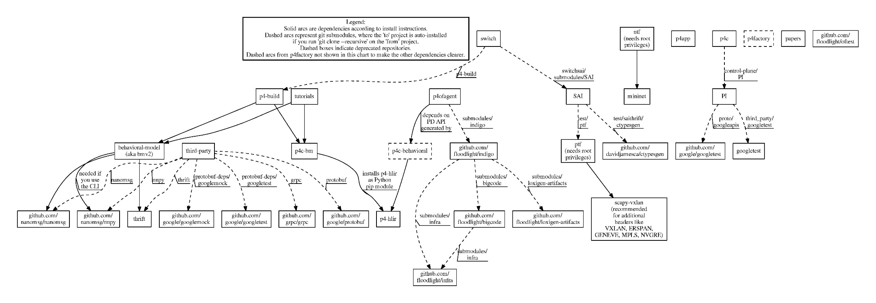
P4 Ecosystem

